Slide 1
Search-Based Approaches to Accelerate Deep Learning
Zhihao Jia

Slide 2
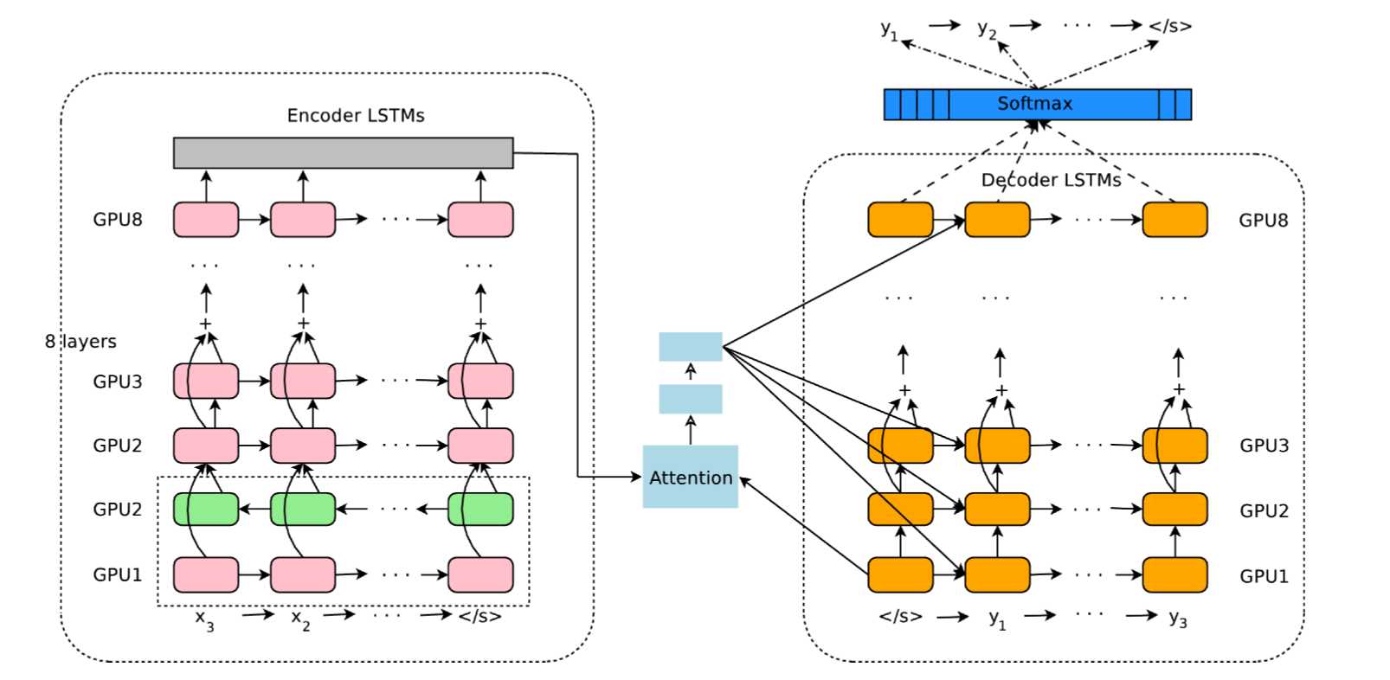
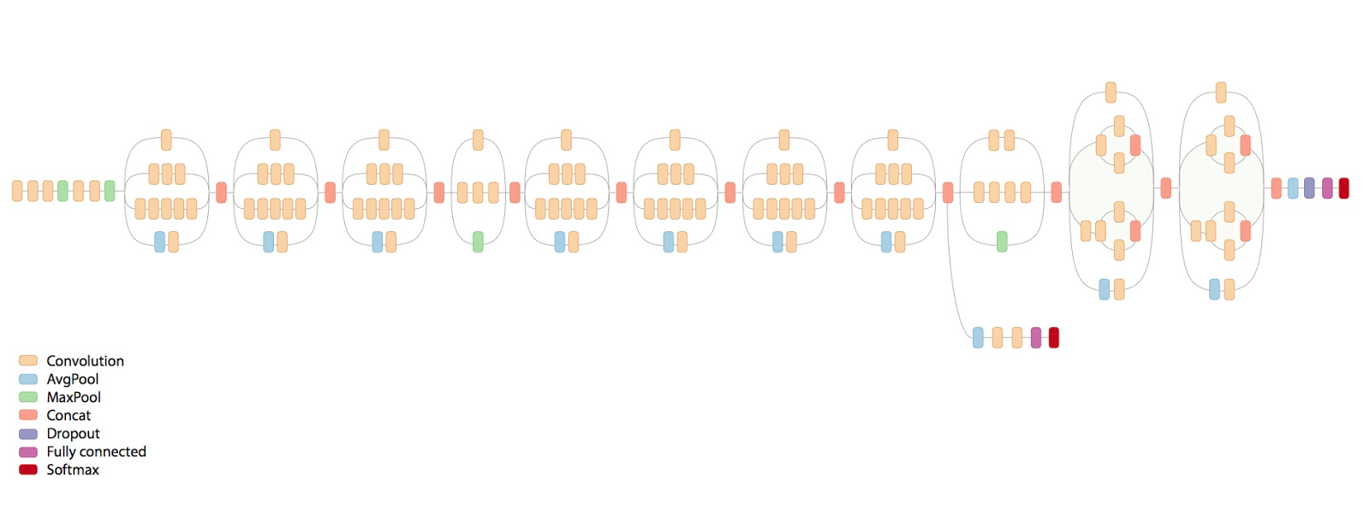
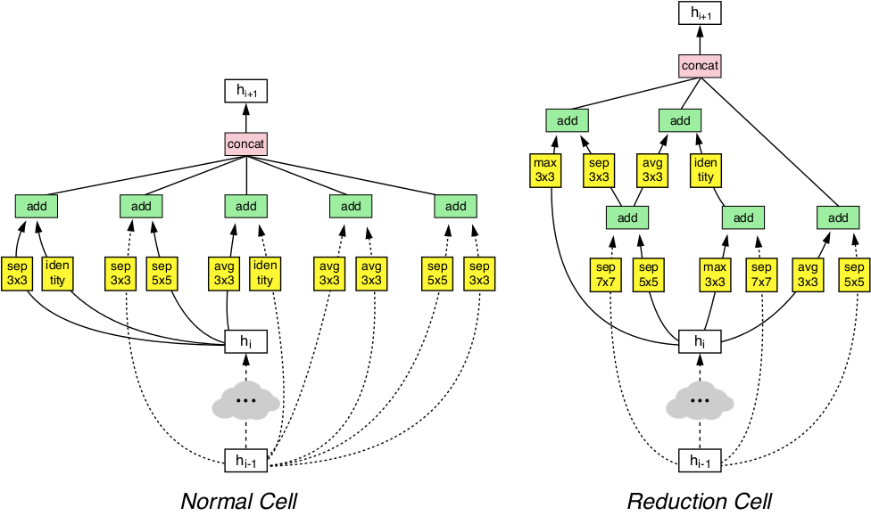
Deep Learning is Everywhere
Convolutional Neural Networks
Recurrent Neural Networks
Neural Architecture Search
Reinforcement Learning

Slide 3

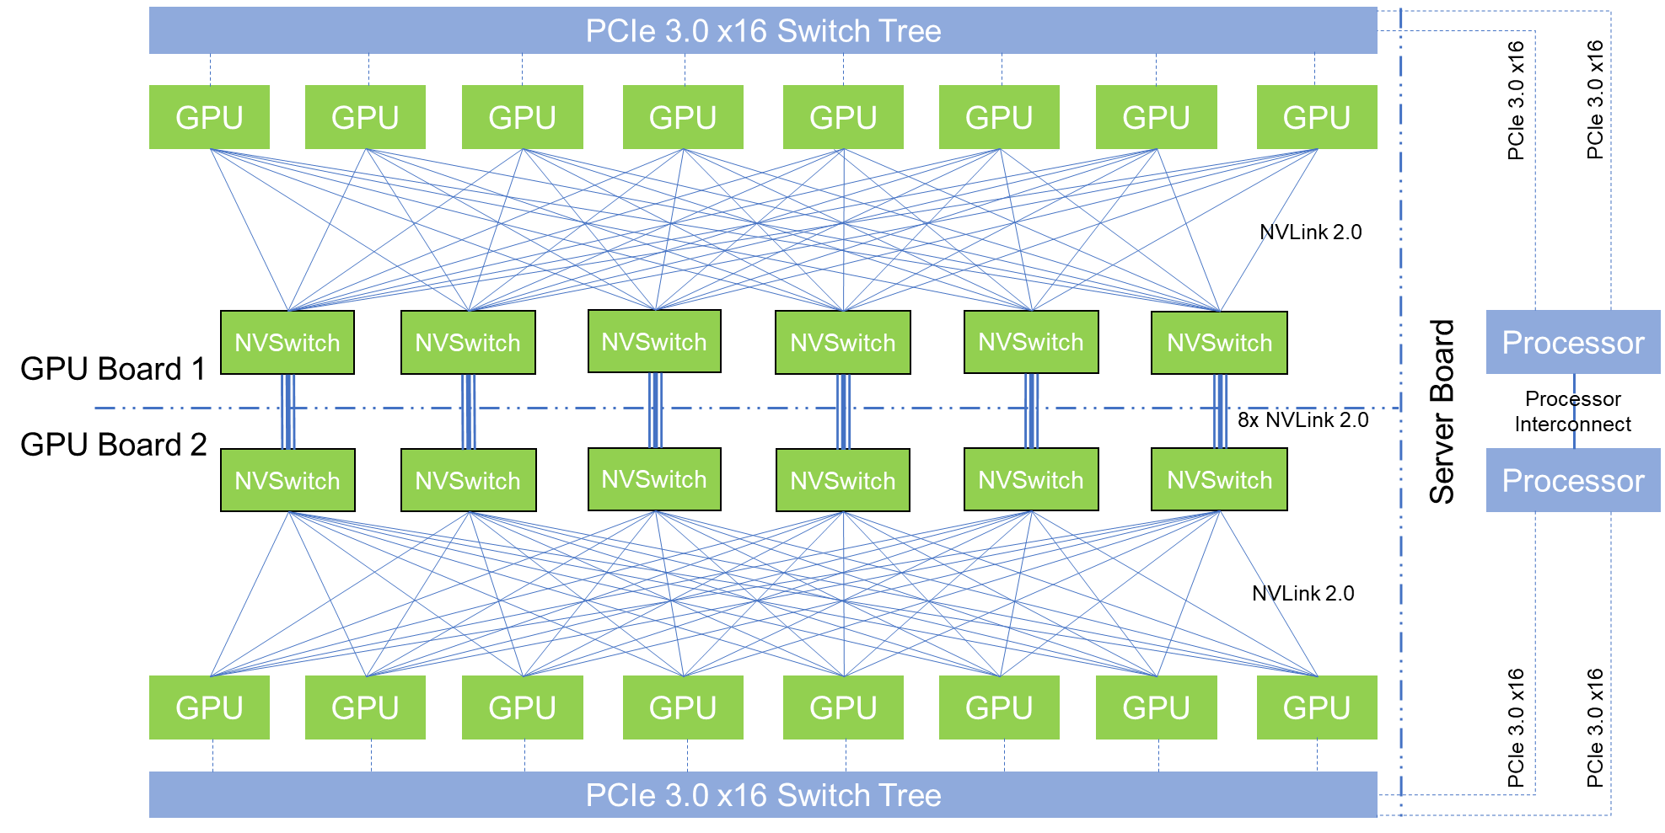
Deep Learning Deployment is Challenging
Diverse and Complex
DNN Models
Distributed Heterogenous
Hardware Platforms
What operators to execute?
How to distribute these operators?

Slide 4
Existing Approach: Heuristic Optimizations
Device 1
Device N
DNN Architecture
Graph Optimizations
Parallelization
Rule-based
Operator Fusion
Data/Model Parallelism
Miss model- and hardware-specific optimizations
Performance is suboptimal

Slide 5
Search-Based Optimizations
A search space of possible strategies
+
A cost model and
a search algorithm
=
Optimized strategies
Challenge 1:
How to build a search space including optimized strategies?
Challenge 2:
How to efficiently explore the search space?

Slide 6
Overview
…
Device 1
Device N
Parallelization
Graph Optimizations
A search space of possible strategies
The SOAP search space
Auto-generated
graph substitutions
+
A cost model and
a search algorithm
Markov Chain
Monte Carlo
Cost-based
backtracking search
=
Optimized strategies
Fast parallelization strategies
Optimized computation
graphs
Outperform data/model parallelism by 3.3x
Outperform rule-based operator fusion by 2.9x

Slide 7

Overview
…
Device 1
Device N
Parallelization
Graph Optimizations
A search space of possible strategies
The SOAP search space
Auto-generated
graph substitutions
+
A cost model and
a search algorithm
Markov Chain
Monte Carlo
Cost-based
backtracking search
=
Optimized strategies
Fast parallelization strategies
Optimized computation
graphs

Slide 8
Beyond Data and Model Parallelism for Deep Neural Networks
ICML’18, SysML’19

Slide 9
Current Approaches: Data and Model Parallelism
Data parallelism is the default strategy in existing DNN frameworks
Manually-designed strategies [1, 2]
Combine data and model parallelism to accelerate specific DNNs
Automatic generated strategies
ColocRL [3] uses RL to find device placement for model parallelism
Exploring dimensions beyond data and model parallelism can further accelerate DNN training (by up to 3.3x)
[1] Alex Krizhevsky. One weird trick for parallelizing convolutional neural networks. 2014
[2] Wu et. al. Google’s neural machine translation system: Bridging the gap between human and machine translation. 2016
[3] Mirhoseini et. al. Device placement optimization with reinforcement learning. 2017

Slide 10
The SOAP Search Space
Samples
Operators
Attributes
Parameters

Slide 11
The SOAP Search Space
Samples: partitioning training samples (Data Parallelism)
Operators
Attributes
Parameters
Pixel
Parameter
Sample
GPU1
GPU2
GPU3
GPU4
Parallelizing a 1D convolution

Slide 12
The SOAP Search Space
Samples: partitioning training samples (Data Parallelism)
Operators: partitioning DNN operators (Model Parallelism)
Attributes
Parameters
Pixel
Pixel
Pixel
Parameter
Parameter
Parameter
Sample
Convolution#1
Sample
Convolution#2
Sample
Convolution#3
GPU1
GPU2
GPU3

Slide 13
The SOAP Search Space
Samples: partitioning training samples (Data Parallelism)
Operators: partitioning DNN operators (Model Parallelism)
Attributes: partitioning attributes in a sample (e.g., different pixels)
Parameters
Pixel
GPU4
Parameter
GPU3
GPU2
Sample
GPU1
Parallelizing a 1D convolution

Slide 14
The SOAP Search Space
Samples: partitioning training samples (Data Parallelism)
Operators: partitioning DNN operators (Model Parallelism)
Attributes: partitioning attributes in a sample (e.g., different pixels)
Parameters: partitioning parameters in an operator
GPU1
Pixel
GPU2
GPU3
Parameter
GPU4
Sample
Parallelizing a 1D convolution

Slide 15
Hybrid Parallelism in SOAP
Example parallelization strategies for 1D convolution
Different strategies perform the same computation.

Slide 16
Parallelization Approach | Sample | Operator | Attribute | Parameter
Data Parallelism | ✓
Model Parallelism |  | ✓ |  | ✓
Manually-designed strategies
(Krizhevsky, 2012) | ✓ |  |  | ✓
(Wu et al., 2014) | ✓ | ✓
Mesh-TensorFlow | ✓ |  |  | ✓
Automatic generated strategies
ColocRL |  | ✓
Tofu and SoyBean | ✓ |  |  | ✓
Gpipe and PipeDream | ✓ | ✓
The SOAP search space
Our work | ✓ | ✓ | ✓ | ✓

Slide 17
Parameter
GPU1
Sample
GPU2
GPU3
GPU4
Data parallelism
A possible parallelization strategy in the SOAP search space

Slide 18
Parameter
GPU1
Sample
GPU2
GPU3
GPU4
Data parallelism
A possible parallelization strategy in the SOAP search space
Notes:
Adding speedup

Slide 19

FlexFlow
DNN Architecture
Device Topology
MatMul
Network
Concat
CPU
CPU
Conv
Conv
GPU
GPU
GPU
GPU
Execution Optimizer
Simulated
Performance
MCMC
Search Alg.
Execution
Simulator
Candidate
Strategy
Search Algorithm
Best Found Strategy
Cost Model
Distributed Runtime

Slide 20
Evaluation
1.7x faster
Training Throughput
(samples per second)
Number of nodes (four K80 GPUs per node)
Speedup Over SOTA
DNNs | AlexNet | ResNet-50 | Inception-v3 | RNNTC | RNNLM | GNMT
FlexFlow | 3.3x | 1.1x | 1.6x | 1.7x | 1.9x | 2.4x

Slide 21
Overview
…
Device 1
Device N
Parallelization
Graph Optimizations
A search space of possible strategies
The SOAP search space
Auto-generated
graph substitutions
+
A cost model and
a search algorithm
Markov Chain
Monte Carlo
Cost-based
backtracking search
=
Optimized strategies
Fast parallelization strategies
Optimized computation
graphs

Slide 22
Optimizing DNN Computation with Automated Generation of Graph Substitutions
SysML’19

Slide 23
Current Practice: Rule-Based Graph Transformations
Apply graph transformations designed by domain experts
E.g., fuse a convolution and a relu into a ``conv + relu’’
Input
Input
Conv3x3
Conv1x1
fuse conv and relu
Conv3x3
+ Relu
Conv1x1
+ Relu
Relu
Relu
Conv3x3
Conv3x3
add
add
relu
relu

Slide 24
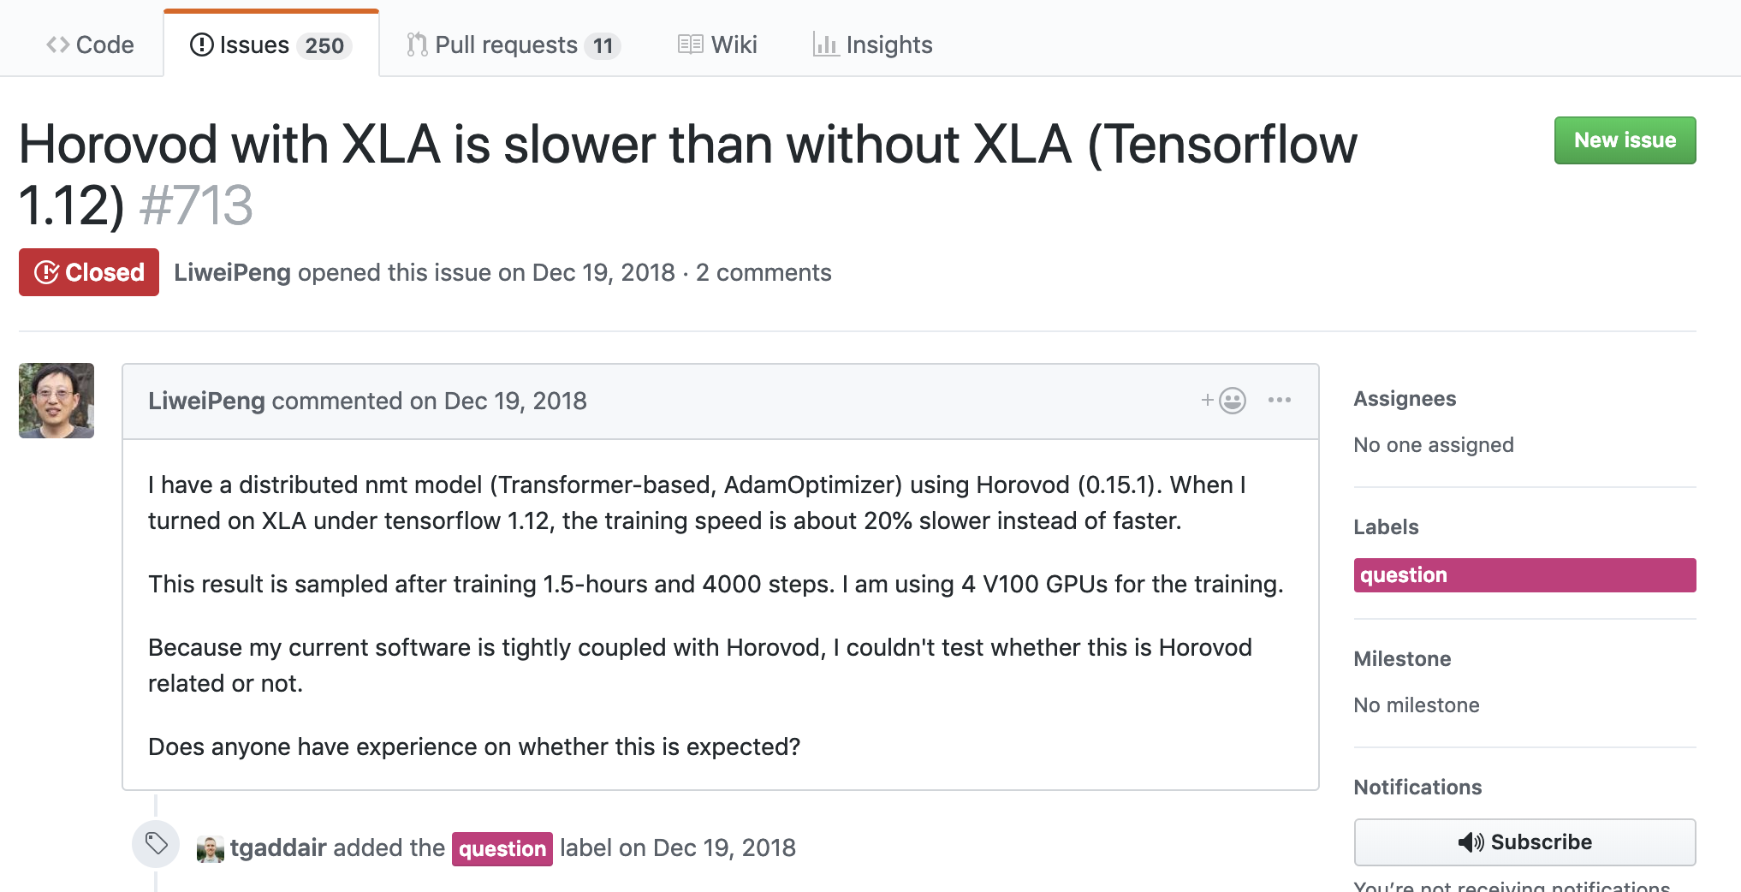
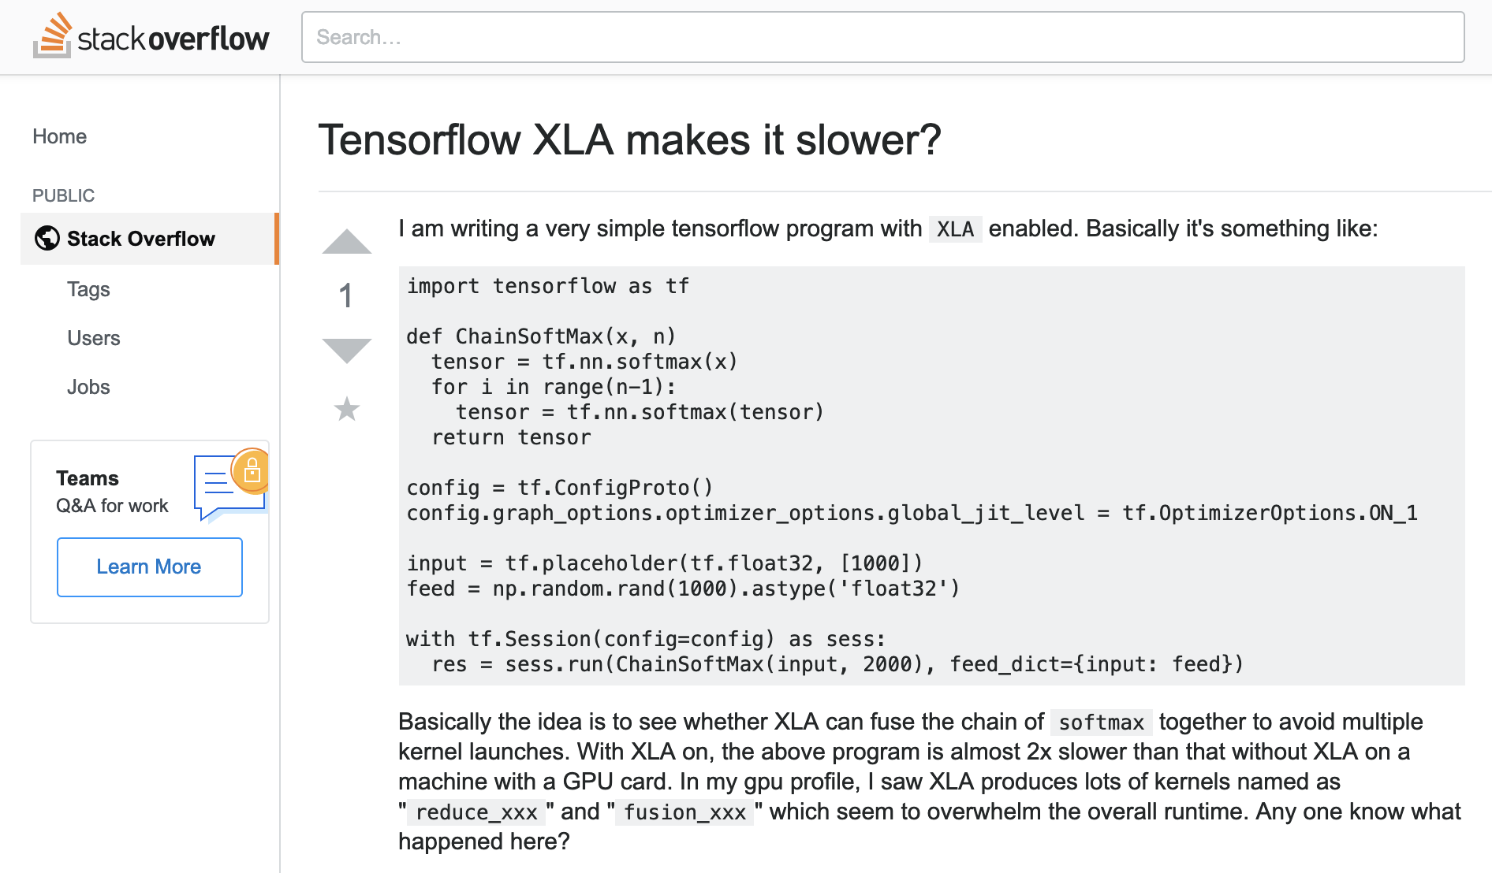
Limitations of Rule-based Approaches
Robustness
Experts’ heuristics do not apply to all DNNs/hardware
When I turned on XLA (TensorFlow’s graph optimizer), the training speed is about 20% slower.
With XLA, my program is almost 2x slower than without XLA

Slide 25
Limitations of Rule-based Approaches
Robustness
Experts’ heuristics do not apply to all DNNs/hardware
Scalability
New operators and graph structures require more rules
Performance
Miss subtle optimizations for specific DNNs/hardware
TensorFlow involves ~4K LOC to optimize a new operator

Slide 26
A Missing Graph Optimization
Input
Input
Input
Input
Input
Conv3x3
+ Relu
Conv1x1
+ Relu
Conv3x3
+ Relu
Conv3x3
+ Relu
Conv3x3
+ Relu
Conv3x3
+ Relu
Conv3x3
+ Relu
Conv3x3
Conv3x3
Split
Conv3x3
Conv3x3
+ Relu
Conv3x3
Add
Add
Relu
Add
Relu
Relu
Relu
Enlarge
convs
Fuse
convs
Fuse
conv & add
Fuse
conv & relu
The final graph is 1.3x faster on V100 but 10% slower on K80.

Slide 27
Can we automatically find these optimizations?
Automatically generated graph substitutions

Slide 28


XFlow
…
Cost-Based Search Alg.
…
Graph Subst. Verifier
Verified Substitutions
Input Comp.
Graph
Optimized
Comp. Graph
…
Graph Subst. Generator
Candidate Substitutions
Operator Specifications

Slide 29
End-to-end Inference Performance
Use ~500 automatically generated substitutions
2.9x
1.5x
1.4x
1.3x
1.0x
Competitive with SOTA
Outperform SOTA on unconventional DNNs

Slide 30
Open Problems
Can we design better search space for parallelization and graph optimizations?
Can we find more efficient search algorithms?
Can we use search-based optimizations in other domains?

Slide 31


Conclusion
…
Device 1
Device N
Parallelization
Graph Optimizations
A search space of possible strategies
The SOAP search space
Auto-generated
graph substitutions
+
A cost model and
a search algorithm
Markov Chain
Monte Carlo
Cost-based
backtracking search
=
Optimized strategies
Fast parallelization strategies
Optimized computation
graphs
https://github.com/flexflow/FlexFlow

Slide 32
Backup Slides

